Slide 1









Speaker | Item
Jess Dillinger | Problem Case
Jess Dillinger | Stakeholder Analysis
Nelson Guinn | Processes
Matthew Perkins | Database Design
Matthew Perkins | Wireframe Design
Guillermo Torres | UI Demos
Guillermo Torres | User Stories and Test Cases
Susan Chen | Model Analysis
Success In Chess
AGENDA

Slide 2

FEPFS ( )
Fidelity Enhanced Price Forecasting System
Content
Item | Content
1 | Describe Variables
2 | Variables Analysis
3 | Histogram
4 | Descriptive Variables
5 | Compare Variables
6 | CDF
7 | Distribution Plot
8 | Test the Hypothesis
9 | Regression Analysis
Help
250 hours/year/broker on portfolio analysis
Unhappy Customers
Help
Help
Can we automate this yet?
Unhappy brokers
Help

Slide 3

Speaker | Item
Jess Dillinger | Problem Case
Jess Dillinger | Stakeholder Analysis
Nelson Guinn | Processes
Matthew Perkins | Database Design
Matthew Perkins | Wireframe Design
Guillermo Torres | UI Demos
Guillermo Torres | User Stories and Test Cases
Susan Chen | Model Analysis
ANALYSIS BACKGROUND
Help
Forecasting stock performance
Help
Help
Help
Popular board game
Rich data sources
Mobile and Tablet App
Connect brokers and customers
Help
Help
Easy to use for
customers and brokers
Help
Interest
Find strategy
Help

Slide 4




Help
250 hours/year/broker on portfolio analysis
Unhappy Customers
Help
Help
Can we automate this yet?
Unhappy brokers
Help
Describe Variables
Rated: This variable indicates whether the chess match was rated or not. A value of "True" signifies that the match was rated, while "False" indicates that it was not rated.
This variable indicates whether the chess match was rated or not. A value of "True" signifies that the match was rated, while "False" indicates that it was not rated.
Turns: The number of turns taken to complete the chess match. This variable provides insight into the duration and complexity of the game.
Victory: Status: This variable specifies the outcome of the game, whether it ended in a victory for one of the players, a draw, or a resignation.
Help
Help
Help
Opening ECO: : The Encyclopedia of Chess Openings (ECO) code for the opening moves played in the match. This code categorizes various chess openings and variations.
Opening Name: : The name of the specific chess opening played in the match. This variable provides further detail about the opening moves chosen by the players.
Winner: : Indicates which player emerged victorious in the match. Possible values include "white," "black," or "draw" for a draw outcome.
Help
Help
Help
Joseph Segal
Project Sponsor
Franco Sevilla
VP Fin Serv
Colin O'Hara
Fidelity SO
Chloe Davis
Broker SME

Slide 5
Hypothetical Question
Is there a statistically significant difference between the mean ratings of white and black chess players?

Slide 6
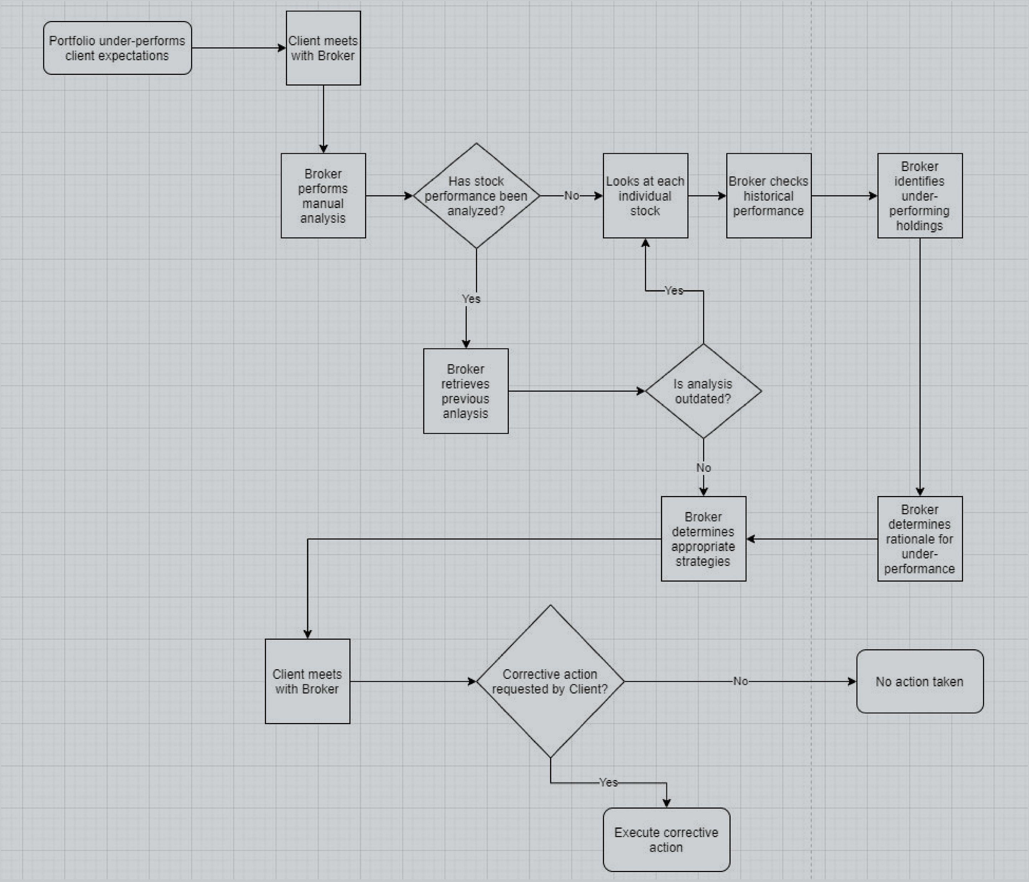
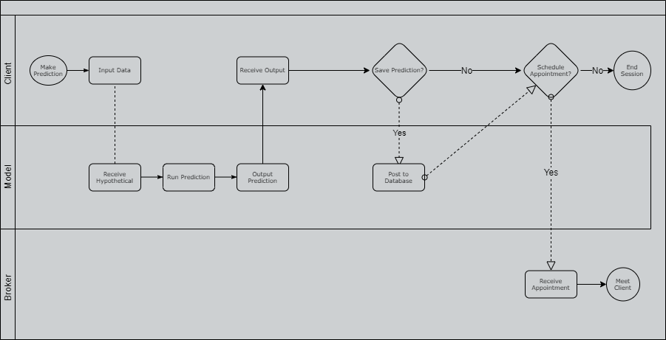
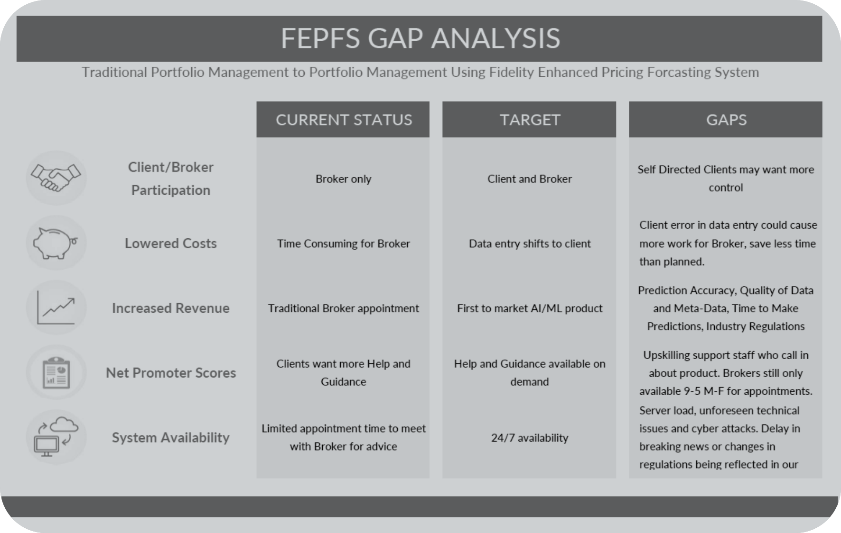

Help
Forecasting stock performance
Mobile and Tablet App
Help
Connect brokers and customers
Easy to use for
customers and brokers
Help
Help
Histogram
Current State
Proposed State
GAP Analysis
Turns
Opening ECO
Opening Ply
White Rating
Black Rating

Slide 7
Joseph Segal
Project Sponsor
Franco Sevilla
VP Fin Serv
Colin O'Hara
Fidelity SO
Chloe Davis
Broker SME
Descriptive Variables
Turns
White Rating
Black Rating

Slide 8
Descriptive Variables
Turns
Mean Turns: 59.34372619436282Spread (Std)
Turns: 32.79123920738702
Tails (Skewness) Turns: 0.8965955362314061
White Rating
Black Rating
Notes:
Client/Broker Participation - As it stands, the entire process starts and ends with an appointment between a Client and a Broker. As a result, the Client is fully reliant on the Broker for any insight or research, no matter how small.
Lowered Costs - The Current Model is heavily reliant on the Broker. There is currently no way for the Client to perform analytics on their portfolio alone. This places significant demand on the Brokers' time, and causes fewer Clients to have their needs met.
Increased Revenue - The norm across the industry for clients to receive insight into their portfolio is to make an appointment and meet with an advisor. We excel because of our top Brokers, Products and Services.
Net Promoter Scores - We are currently receiving feedback from Clients that states they want more Help and Guidance from Fidelity. The Current Model requires setting an appointment, limiting the access to said Help and Guidance through our Brokers.
System Availability - The Current Model has extremely limited availability. A Client must make an appoitment that usually last a couple of hours at most. Significant planning is required to make the most of limited time.

Slide 9
Joseph Segal
Project Sponsor
Franco Sevilla
VP Fin Serv
Colin O'Hara
Fidelity SO
Chloe Davis
Broker SME
Descriptive Variables
Turns
White Rating
Black Rating

Slide 10
Descriptive Variables
White Rating
Mean White Rating: 1595.1694961366852
Spread (Std) White Rating: 290.281812118375
Tails (Skewness) White Rating: 0.29543523362766727
Turns
Black Rating
Notes:
Client/Broker Participation - This Model allows Clients to use the same system a Broker would use to input data and make predictions, but stops short at letting them implement changes. It also allows for concurrency between Broker and Client.
Lowered Costs - The Target Model succeeds in handing more power to the Client, freeing up a significant amount of time for our Brokers to assist more Clients. Resulting in lower costs per client helped.
Increased Revenue - The Proposed Model gives us a completely new way to stand out from the competition. Use of AI/Machine Learning would make us an industry leader by introducing a product that could be the first of its kind, resulting in more Clients.
Net Promoter Scores - The Target Model seeks to provide a sort of "On Demand" Help and Guidance tool that clients can access at any time. This could see our NPS scores increase as a result.
System Availability - Our Proposed Model theoretically should be up 24/7. Even if it is taken down at night for maintenance/upgrades, clients will feel like they have exponentially more time to receive professional insight from Fidelity.

Slide 11
Joseph Segal
Project Sponsor
Franco Sevilla
VP Fin Serv
Colin O'Hara
Fidelity SO
Chloe Davis
Broker SME
Descriptive Variables
Turns
White Rating
Black Rating

Slide 12
Descriptive Variables
Black Rating
Mean Black Rating: 1586.9201762977473
Spread (Std) Black Rating: 290.6106468642933
Tails (Skewness) Black Rating: 0.26523329742734925
Turns
White Rating
Notes:
Client/Broker Participation - While the Target succeeds in providing Clients with more transparency and insight into their portfolio, they cannot implement changes without meeting a Broker. Highly educated self-directed clients may see this an annoyance.
Lowered Costs - The Target Model relies on Clients accurately inputting data. Anything entered incorrectly could cause more work for the Broker - resulting in less time saved than originally anticipated, and lower cost savings.
Increased Revenue - New technology is not without fault. Major concerns would be Prediction Accuracy, Quality of Data and Meta-Data used to train the model, Time to Make Predictions, and Setting Proper Expectations as to the new model's capabilities.
Net Promoter Scores - While the tool will be available 24/7, access to a Broker to implement changes is not. This may require upskilling of Phone Representatives to better explain features of the tool to support Clients around the clock, in anticipation of their appointment with a Broker.
System Availability - Issues may include server load, unforeseen technical issues and cyber attacks. There may also be a delay in breaking news or changes in regulations being reflected in our analysis.

Slide 13
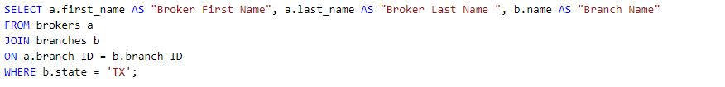
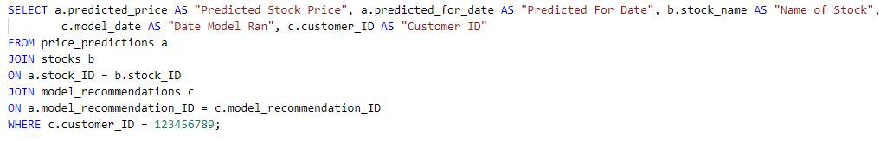
PMF of Turns for Rated vs Unrated Games
Broker Lookup
Saved Model Lookup​

Slide 14
CDF of Number of Turns in Chess Games

Slide 15
Scatter plot for White Rating vs. Black Rating

Slide 16
Data Analysis
The Hypothesis
Understanding
Hypothesis
Statistic Results
Is there a statistically significant difference between the mean ratings of white and black chess players?
Interpret Results
Trend
Seasonality
Residual
Regression Result
Interpret
Regression
Notes:
Our problem is twofold:
Brokers spend too much time on calculating returns manually ( case study cites 250hr/broker/year could be saved)
Clients are dissatisfied when they have their concentrated positions plateau out
These are our 2 distinct user groups
Solution for brokers will resemble a tool to supplement their research
Solution for clients will resemble more a way for them to manage risk and obtain digestible research
Why?
No ML model can completely reduce risk b/c systematic risk is undiversifiable

Slide 17


Brokers
Customers
Model Analysis
Statistic Results
Understanding
Hypothesis
Statistic Results
Convert into Supervised Learning Model
Autoregressive Integrated Moving Ave.
RNN, more robust on missing data
Problem Transformation
Linear Model
Long Short-Term Memory
T-statistic: 2.72
P-value: 0.0065
Interpret Results
Regression Result
Interpret
Regression
Notes:
Time Series definition
3 major components: trend + seasonality + residual
Autocorrelation ->when sequential points in the series exhibit correlation (autocorrelation is bad )
Stationarity -> statistical properties (mean, variance, covariance) do NOT change over time (having stationarity is also bad)
Non stationarity data is harder to predict on
Should not exhibit trend
Methods to correct for trend and seasonality
Differencing
Decomposition

Slide 18
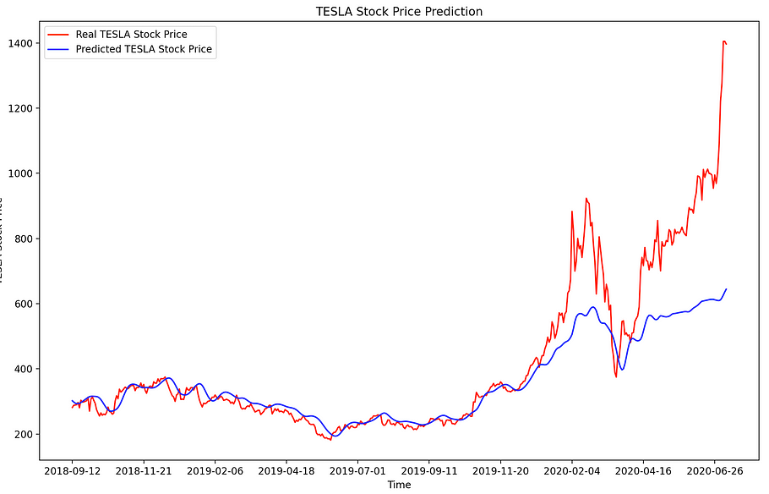
Trend
Seasonality
Residual
Model Analysis
Interpret Results
Understanding
Hypothesis
Ex. of LSTM Model
1. Correlated
Assets
2. Technical
Indicators
3. Performance
Reports
4. News
Statistic Results
Since the p-value is less than the significance level (assuming α = 0.05), we reject the null hypothesis. This means that there is a significant difference between the mean ratings of white and black players.
Interpret Results
Regression Result
Lockdowns
Interpret
Regression
Notes:
3 Buckets of Modeling Techniques
Modify the time series for Supervised Learning
Restructure the data into inputs (X) and outputs (Y)
Preserves the order of observations
ARIMA – combines autoregression with stationarity and a moving average model
LSTM – deep learning approach that uses hyperparameters such as a gates to optimally let data pass through or be disposed
Black box method
less interpretability

Slide 19
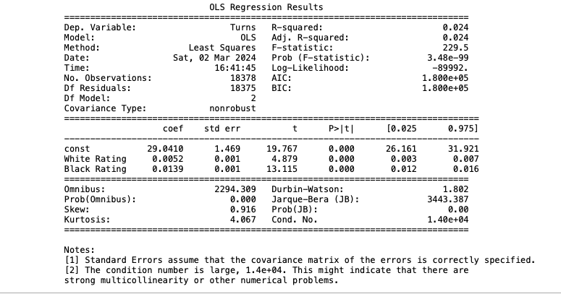
Convert into Supervised Learning Model
Autoregressive Integrated Moving Avg.
RNN, more robust on missing data
Problem Transformation
Linear Model
Long Short-Term Memory
Model Analysis
Regression Result
Understanding
our Problem
Est. Training Cost
vCPU | GiB | Standard Instances ($/HR) | ML Savings Plan (1 year; $/HR) | Managed Spot Training (as of May 2023; $/HR)
64 | 256 | $3.686 | $2.7084 | $1.9359
8 | 32 | $.399 | $0.28788 | $0.267
4 | 16 | $.20 | $0.144 | $0.1308
2 | 8 | $.10 | $0.072 | $0.064
Understanding
our Data
Standard Instances
$4209.6
Models
ML Savings Plan for 1YR
$3083.79
6 Months ≈ 120 days
Regression Result
Spot Training
$2301.79
8 Hrs/Day
Interpret
Regression
312 GiB
Notes:
Chart -> LSTM on Telsa stock with lag period of 1
There are part of the residuals
Correlated assets (commodities, FX broad based indices)
Technical indicators (moving avg. exponential moving avg. momentum)
Key Metrics (ROE, P/E ratio)
News (upcoming events)

Slide 20
Ex. of LSTM Model
1. Correlated
Assets
2. Technical
Indicators
3. Performance
Reports
4. News
Lockdowns
Model Analysis
Interpret Regression
Understanding
our Problem
R-squared and Adjusted R-squared = 2.4%
The model has limited explanatory power.
Understanding
our Data
while the ratings of both white and black players have statistically significant effects on the number of turns in a chess game, the explanatory power of the model is relatively low, and there may be multicollinearity issues to address.
Statistical Significance < 0.05
Models
Regression Result
Model Fit = 229.5
The overall model is statistically significant
Interpret
Regression
Notes:
SageMaker Price May 2023 (vCPU | GiB | $/hr):
ml.m5.16xlarge 64 256GiB $3.686
ml.t3.2xlarge 8 32GiB $0.399
ml.t3.xlarge 4 16GiB $0.20
ml.t3.large 2 8GiB $0.10
Total for standard instances : 4.385/hr
Total training cost per strategy
Standard instances : $4209.6
ML Savings Plan: $3,083.7888
Managed Spot training: $2,301.792
TCO will be more once deployment cost is factored in

Slide 21
THANK YOU!
Questions, Comments, Suggestions?

